Slide 1
Environmental Strategies (P.I.R.E.)
Jerry Bennett, Community Development Specialist, FL PRC
Earl Greene, Community Development Specialist, FL PRC
Barb Christensen, Coordinator, FL PRC

Slide 2

Funding for Prevention Resource Centers is provided by the Office of Alcoholism and Substance Abuse Services

Slide 3
Environmental Strategies:
Roles for Communications Media
Al Stein-Seroussi
Pacific Institute on Research and Evaluation (P.I.R.E.)

Slide 4
Today’s Agenda
Overview: Environmental Strategies and the research
Use of communications media to support environmental strategies

Slide 5
Today’s Agenda
III. Distinguish between different media strategies:
    Media Advocacy
    Social Marketing
    Social Norms Misperceptions Campaigns
IV. Social Norms Misperceptions Campaigns
    Norms Change Theory and the Evidence-base
    Core components
    Support for Implementation Fidelity

Slide 6
OASAS Prevention Services
Education
Positive Alternatives
Information/Awareness
Community Capacity Building
Early Intervention
Prevention Counseling
Environmental Strategies

Slide 7
Defining the Seven Strategies for Community Change
Providing Information
Enhancing Skills
Providing Support
Enhancing Access/Reducing Barriers
Changing Consequences
Physical Design
Modifying/Changing Policies

Slide 8
Overview:
What are Environmental Strategies?
Strategies aimed at changing and managing environments to promote healthy choices.
Typically directed at limiting availability and access to substances of abuse.

Slide 9
Overview:
What are Environmental Strategies?
Goal is to effect population-based change.
Can be implemented nationally (e.g., Minimum Drinking Age laws), at the state level (e.g., ABC policies), and locally (e.g., smoking in public places ordinances).

Slide 10

A Comprehensive Approach
Environmental Strategies
work to address
conditions
in the
shared
environment
Individual Strategies
work to
change
conditions
within
each
individual

Slide 11
Comparison of Prevention Strategies
Strategies Targeting Individuals
Socialize, Instruct, Guide, Counsel
Strategies Targeting the Environment
Support, Thwart
Family
School
Workplace
Regulations
Faith Community
Individual
Health Care Providers
Community
Norms
Availability

Slide 12
Individual Strategies Environmental Strategies
Focus on individual behavior and behavior change
Focus on the relationship between the individual and alcohol/drug-related problems
Focus on individual development
Focus on personal control
Focus on policy and policy change, laws & norms
Focus on the social, political and economic context of alcohol/drug-related problems
Focus on policy development
Focus on community control

Slide 13
How are Environmental Strategies Distinct from Other Prevention Strategies?
Often aimed directly at gatekeepers of environments (think availability and access), rather than individual users (or potential users).
Often involve laws, policies, and regulations, along with enforcement and media.
Often have consequences associated with non-compliance.

Slide 14
Environmental Prevention Strategies
Evidence of Effectiveness
They are based on the fact behavior is powerfully shaped by the environment
They are designed to change the physical, legal, economic and social processes of communities in ways that are associated with substance abuse
They use public policies (laws, rules, regulations)
and community – level interventions that can affect whole populations
THEY ARE COMMUNITY-BASED AND COMMUNITY DRIVEN

Slide 15
The most effective environmental prevention strategies employ a three-pronged approach:
1.The enacting or improving of laws, regulations and policies,
2.Enhancing enforcement of the law, regulation or policy, and
3.The use of the media to raise community awareness and support for the policy and enforcement activities.
Offices of Alcoholism & Substance Abuse Services (OASAS)

Slide 16
Environmental strategies incorporate prevention efforts aimed at changing or influencing community conditions, standards, institutions, structures, systems and policies.
“The Coalition Impact: Environmental Prevention Strategies”
Community Anti-Drug Coalitions of America (CADCA

Slide 17
Your community is
perfectly engineered to get the
results you are
currently getting.
- Community Anti-Drug Coalitions
of America (CADCA)

Slide 18
Examples of Environmental Strategies (Policies and Enforcement)
Driving Under the Influence
Lower BACs, including zero tolerance for minors
High visibility sobriety checkpoints
Social Availability
Underage drinking party dispersal
Social host ordinance
Party patrols
Shoulder taps

Slide 19
Examples of Environmental Strategies (Policies and Enforcement)
Retail Access
Minimum drinking age
Hours/days of sales
Density of outlets
Responsible beverage server training
Liability for alcohol sales
Compliance checks/purchase attempts

Slide 20
Examples of Environmental Strategies (Policies and Enforcement)
Price
Taxes
Limits on discounts (e.g., happy hours)
Promotion
Public advertising restrictions
Alcohol sponsorship restrictions at public events
Restrict AOD Merchandise sales at public events

Slide 21
Examples of Environmental Strategies (Policies and Enforcement)
Community Norms
Public availability and alcohol use
School substance use policies
Workplace substance use policies
Alcohol use restrictions at public events
Social norms misperception campaigns

Slide 22
Not Just Alcohol….
Marijuana Use
Environmental strategies could be similar to those used for alcohol (e.g., taxation, minimum age laws, retail licensing and compliance checks, DUI laws and sobriety checkpoints, social host liability)

Slide 23
Not Just Alcohol….
Prescription Drugs/Opioids
Limits on prescription amounts and refills
Mandatory use and monitoring of PDMP, with sanctions for physicians out of compliance
Narcan availability throughout community

Slide 24
Activity 1a:
Is this an environmental strategy?
The town of Yankeeville school board has a policy that all public schools must implement an evidence-based ATOD prevention curriculum.
Notes:
NO – it may be universal, but no changes made to the ENV, individual students will have better skills and reduced risk, but pop norms of all youth are not impacted.

Slide 25
Activity 1b:
Is this an environmental strategy?
A Coalition in town of Giantsboro uses mass media channels to disseminate messages about the dangers of ATOD use
Notes:
No!, there is no logic model and plan for ENV change, no sub-pops targeted, no messages crafted to change norms in a pop., no tie in to Policy/Enforcement

Slide 26
Relationship Between Policies, Media, and Enforcement
Policies
BAC limits
Minimum Drinking Age
Social host laws
Media
Public awareness about policies
Public awareness about consequences
Enforcement
High visibility sobriety checks
Compliance checks
Party patrols

Slide 27
Role of Media in Environmental Strategies
The use of media, in and of itself, is generally not an environmental strategy.
Media can shape environments, but is often too diffused and aimed at individual decision makers (e.g., alcohol consumers).

Slide 28
Role of Media in Environmental Strategies
Media can, and should, be used to support environmental policy and enforcement.
    Awareness of policies
    Awareness of enforcement
    Awareness of consequences
    Public support for all the above

Slide 29
3 Most Popular Environmental Media Strategies used by OASAS Providers:
Media Advocacy Campaign
Social Marketing Campaign
Social Norms Misperception Campaign

Slide 30
OASAS Provider Environmental Media Strategies by Region
Notes:
-Handout in packet has list of ENV media providers

Slide 31
Media Advocacy
The strategic use of media to support community organizing and advance public health policy.
Aimed at policy makers to influence policy change and community members to garner public support.
Example:
  - Oakland coalition’s effort to develop an ordinance that requires education, monitoring, and enforcement for alcohol retailers.
Notes:
Should EBP ENV M.A. be limited to supporting Policy as described above?

Slide 32
Media Advocacy
Resources
  CADCA (http://www.cadca.org/sites/default/files/resource/files/workingwithmedia.pdf)
  Berkeley Media Studies Group (www.bmsg.org)
  California Endowment (http://sph.berkeley.edu/sites/default/files/Communicating-for-Change-Making-the-Case-for-Health-with-Media-Advocacy.pdf)

Slide 33
Media Advocacy
Core Components
Get to know media contacts
Monitor the media, including industry ads, research reports, and local news stories
Frame the issue:
  - Describe the issue at hand
  - Describe what you want to change and how to change it
  - Know who can make the change
Notes:
Should EBP ENV M.A. be limited to supporting Policy as described above?

Slide 34
Media Advocacy
Core Components
Stay on message by keeping to the three framing components and repeat if time permits
Ensure messages are linked to issues with which the public has concerns
Use local statistics to tell the story

Slide 35
Media Advocacy Fidelity Scale

Slide 36
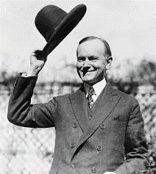


End of Part 1
Break Time !!!

Slide 37
Social Marketing
The use of commercial marketing approaches to influence attitudes and behaviors for societal benefit (rather than commercial benefit).
Usually aimed at a specific sub-population to be effective.
Primary focus is the consumer—learning what people want and need rather than trying to persuade them to want what you are selling.

Slide 38
Social Marketing
The four Ps of marketing: product, price, place, promotion
Additional Ps: partnerships and public policy
Example:
  Gwinnett county coalition’s effort to increase awareness of damage that alcohol has on developing brain
Resources
  CADCA (http://www.cadca.org/sites/default/files/resource/files/workingwithmedia.pdf)

Slide 39
Social Marketing
Core Components
Mass media/social marketing plan has been written and documented and identifies:
  1) goals and objectives
  2) the target audience
  3) behaviors or norms targeted
  4) strategy to be used

Slide 40
Social Marketing
Core Components
Formative research conducted to understand and test the target audience responses to the messages, media channels (web, TV, billboards, person-to-person, etc.), and messenger/spokesperson (if applicable).

Slide 41
Social Marketing
Core Components
Collect and report local data to reinforce message prior to, and after the campaign.
Campaign employs multiple media channels.
Research (literature review, focus groups, testing with surveys, etc.) conducted to determine appropriate frequency of exposure for target audience.
Message repeated appropriately, as determined by research.

Slide 42
Social Marketing Fidelity Monitoring 1: Ratings by an Outside Party

Slide 43
Social Marketing Fidelity Monitoring 2: Tracking by Provider
Social Marketing | Response options | Frequency
Mass media/social marketing plan has been written and documented and identifies: 1) goals and objectives; 2) the target audience; 3) behaviors or norms targeted; and 4) strategy to be used. | Not started In progress/ongoing Completed | semi-annually
Media messages developed. | Not started In progress/ongoing Completed | semi-annually
Formative research conducted to understand and test the target audience responses to the messages, media channels (web, TV, billboards, person-to-person, etc.), and messenger/spokesperson (if applicable). | Not started In progress/ongoing Completed | semi-annually
During the past six months, what types of media did you use? | Brochures | semi-annually
 | Community events
 | Print media
 | Press release
 | PSAs
 | Radio
 | Social Media
 | Television
 | Website
 | Other
 | Other (please specify):

Slide 44
Social Marketing and Media Advocacy:
Complementary Approaches
Social Marketing campaigns can motivate individual behavior change, but impact will be temporary, unless environmental changes are also made for the long run.
Media Advocacy can be used to motivate decision-makers to generate those long-term policy and enforcement changes.
Social Marketing, in turn, is well- suited to motivate consumers to support policy and enforcement changes.
Nedra Kline Weinrich, Weinrich Communications (http://www.social-marketing.com/whatis.html)
Notes:
-Just like EBP Education, Social Marketing messages must be updated and re-disseminated for new cohorts of teens, parents, etc. Policy change can last decades – like the 21 year old drinking age.

Slide 45
Environmental Media Strategies vs. Public Information/Awareness
Environmental Media Strategies | Information/Awareness activities
Social Marketing campaign Media Advocacy Social Norms Misperception campaign Retail outlet recognition campaign Information/warning signs (outlets) | Public service announcements Resource directories Other printed material Telephone information services Walk-in information services Health promotion event Speaking events Internet – site content Internet – social media Newspaper – content Television/radio – content

Slide 46
Environmental Media Strategies vs. Public Information/Awareness
Key difference is the focus and level of diffusion.
Any given ENV media strategy will use multiple media channels, but all will be focused on supporting policies and/or changing social norms in a comprehensive fashion.
Information/awareness efforts tend to be isolated.

Slide 47
Environmental Performance Standards for OASAS Providers
OASAS categorizes the ENV strategies as EBP’s (see Prev. Guidelines, Appendix H)
For providers, Environmental Media strategies must support ENV Policy and/or Enforcement strategies.
Policy/Enforcement efforts may be led by a coalition, but providers must identify the specific strategies in the community being supported by the ENV media strategies.
Notes:
-Handout in packet has list of OASAS ENV media providers

Slide 48
Social Norms Misperceptions (SNM) Campaigns
Our perceptions of peer attitudes and behaviors are often inaccurate
So, providing accurate data about risky behaviors, can (a) influence perceptions of peer attitudes and behaviors and (b) modify our own behaviors to be in line with those more accurate perceptions
If I believe everyone’s doing it, I am more likely to do it. If I see that everyone’s not doing it, I am less likely to do it.

Slide 49
Social Norms Misperceptions (SNM) Campaigns
Our perceptions of peer attitudes and behaviors influence our own attitudes and behaviors
We often perceive that our peers endorse risky attitudes and engage in risky behaviors (“everyone at my high school….drinks, smokes, gets high, has sex….”)

Slide 50
Social Norms Misperceptions (SNM) Campaigns
SNM campaigns involve two overarching components:
Collection of pre- and post-data about….
  Perceptions about normative behavior
    Ex: Within the last 30 days, what percent of students at your school used….alcohol, cigarettes, marijuana, Rx drugs without a Rx, etc.
  Actual normative behaviors
    Ex: Within the last 30 days, on how many days did you use…alcohol, cigarettes, marijuana, Rx drugs without a Rx, etc.
Media-based intervention aimed at correcting misperceptions of norms

Slide 51
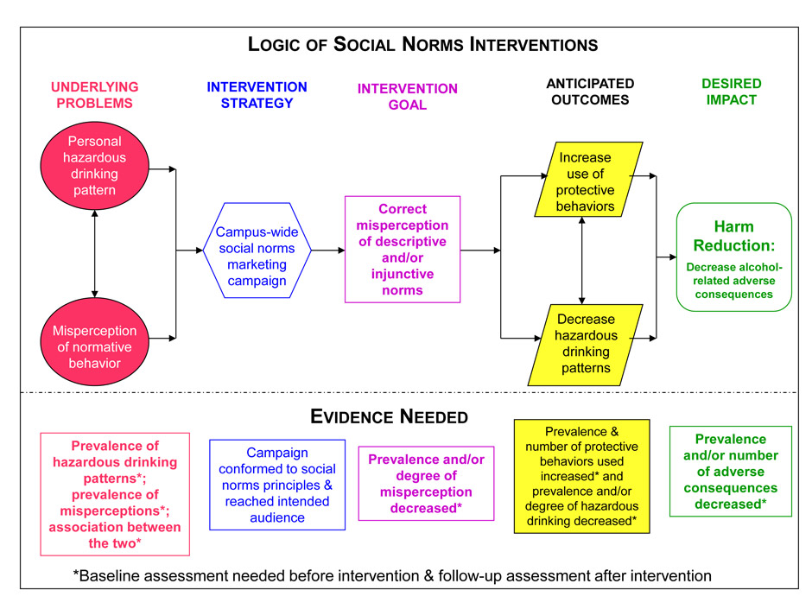
Source: National Social Norms Center at Michigan State University

Slide 52
Social Norms Misperception Campaigns
CORE Components:
1. Establish baseline rate of behaviors and attitudes of interest
  Quantity/frequency of targeted behaviors
  Perceptions of behaviors of others (must correspond to actual behaviors)
2. Test to see if there is a misperception—is the perception of the risky behavior significantly higher than the actual?
Source: National Social Norms Center at Michigan State University

Slide 53
Social Norms Misperception Campaigns
CORE Components:
3. Test to see if the misperception is associated with risky behavior—do people who “binge drink” more often have greater misperceptions of the behavior prevalence?
4. Establish the percent of population that have normative misperceptions and risky behavior.
Source: National Social Norms Center at Michigan State University

Slide 54
Social Norms Misperception Campaigns
CORE Components:
Design the SNM campaign
  Use target population to develop media messages and marketing strategies
  Ensure messages are Positive, Inclusive, and Empowering (PIE)
  Use a variety of messages and media delivery strategies
Source: National Social Norms Center at Michigan State University

Slide 55
Social Norms Misperception Campaigns
CORE Components:
Conduct follow-up survey of target population to measure:
  Exposure: What percentage of population saw the message?
  Saturation: How frequently did they see message?
  Use the same questions at pre-test and after the campaign for outcome evaluation.
Source: National Social Norms Center at Michigan State University

Slide 56
Social Norms Misperception Campaigns
CORE Components:
Evaluate to see if there is:
  Decrease in misperceptions of behavioral norms (e.g., how many of my peers are binge drinking)
  Decrease in the actual substance use behaviors
Source: National Social Norms Center at Michigan State University

Slide 57
Social Norms Misperception Campaign
Fidelity Monitoring: Provider Tracking
 | Response options | Frequency
Social norms plan has been written and documented and identifies: 1) goals and objectives; 2) the target audience; 3) behaviors or norms targeted; and 4) strategy to be used. | Not started In progress/ongoing Completed | semi-annually
Data collected with the target audience to provide an accurate picture of what the social norms are (behavioral data) and what the perceptions are of the norms (perceptions of peer behavior). | Not started In progress/ongoing Completed | semi-annually
Media messages developed that are (1) positive, inclusive, and empowering; (2) used data to reinforce social norms; and (3) display source of data | Not started In progress/ongoing Completed | semi-annually
Formative research conducted to understand and test the target audience responses to the messages, media channels (web, TV, billboards, person-to-person, etc.), and messenger/spokesperson (if applicable). | Not started In progress/ongoing Completed | semi-annually
During the past six months, what types of media did you use? | List all options | semi-annually
Data collected with the target audience to determine if perceptions and behaviors changed. | Not started In progress/ongoing Completed | semi-annually

Slide 58
Available Surveys Suitable for SNM Campaigns: Youth Development Survey (YDS)*
Items: Now think about all the students in your grade at your school. How many do you think…
    - Smoke one or more cigarettes a day?
    - Drank alcohol sometime in the past 30 days?
    - Used marijuana sometime in past 30 days?
    - Used an illegal drug in past 30 days (not including marijuana)
* Not public domain, but used throughout the State of NY

Slide 59
Available Surveys Suitable for SNM Campaigns: Youth Development Survey (YDS)*
Response Options:
    None (0%)
    Few (1-10%)
    Some (11-30%)
    Half or less (31-50%)
    Half or more (51-70%)
    Most (71-90%)
    Almost all (91 – 100%)

Slide 60
Available Surveys Suitable for SNM Campaigns:
American College Health Association National College Health Assessment (ACHA NCHA II)*
Within the last 30 days, what percent of students at your school used:
  Cigarettes
  Alcohol
  Marijuana
Response options ranging from 00 – 99 percent
* Not public domain

Slide 61
Evidence of Positive Effects
Most research studies with experimental or quasi-experimental designs involve college students
Recent review by Foxcroft et al. (2015) examined outcomes of 70 randomized control trials at colleges and universities, looking at measures at four or more months post-intervention

Slide 62
Evidence of Positive Effects
Found small but significant effects on….
  Alcohol-related problems
  Binge drinking
  Drinking quantity
  Drinking frequency
  BAC
Strength of effects over the longer-term is very small

Slide 63
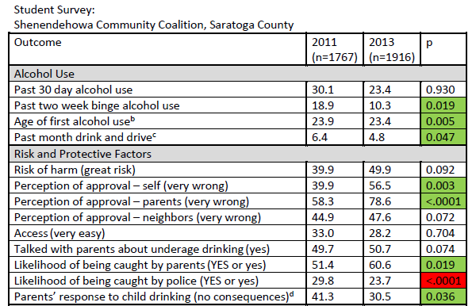
NYS OASAS SPF-SIG: ENV Outcomes

Slide 64
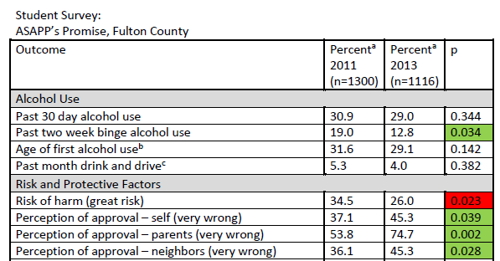
NYS OASAS SPF-SIG: ENV Outcomes

Slide 65
Activity 1a: Use of Data
What could be the message(s) of a SNM campaign using these data?
 | Sex |  | Grade
 | Female | Male | 9 | 10 | 11 | 12
Drank alcohol | 32.4 | 26.8 | 26.4 | 29.3 | 31.8 | 34.4
Binge drank | 15.6 | 15.5 | 12.5 | 14.6 | 15.9 | 17.9
Used marijuana | 19.1 | 18.9 | 16.8 | 18.5 | 19.7 | 22.3
Drove when they had been drinking alcohol | 5.5 | 10.1 | - | 2.6 | 6.3 | 8.9
Texted or emailed while driving | 26.5 | 30.6 | 20.2 | 24.0 | 27.5 | 30.5
Think there is moderate/great risk of harm of someone their age drinking alcohol | 73.3 | 72.1 | 80.6 | 76.5 | 73.2 | 71.5
Think it’s wrong/very wrong for someone their age to drink alcohol | 65.6 | 67.3 | 75.4 | 68.6 | 66.8 | 61.2
Perceive their friends think it’s wrong/very wrong for them to drink alcohol | 75.4 | 78.8 | 70.3 | 78.6 | 73.1 | 71.2
Perceive their parents think it’s wrong/very wrong for them to drink alcohol | 77.8 | 74.7 | 80.6 | 78.6 | 74 | 70.3
Notes:
Trick question: Even though there are lots of data, there are not any data related to perceptions of actual behaviors; therefore, no misperception can be established. Data could be used for a social norms campaign that reinforces high rates of disapproval, but that is not a social norms misperception campaign.

Slide 66
Activity 1b: Use of Data
What could be the message(s) of a SNM campaign if you had these data available?
 | Sex |  | Grade
 | Female | Male | 9 | 10 | 11 | 12
Drank alcohol in past 30 days | 32.4 | 26.8 | 26.4 | 29.3 | 31.8 | 34.4
Binge drank in past 30 days | 15.6 | 15.5 | 12.5 | 14.6 | 15.9 | 17.9
Used marijuana in past 30 days | 19.1 | 18.9 | 16.8 | 18.5 | 19.7 | 22.3
Drove when they had been drinking alcohol in past 30 days | 5.5 | 10.1 | - | 2.6 | 6.3 | 8.9
Texted or emailed while driving in past 30 days | 26.5 | 30.6 | 20.2 | 24.0 | 27.5 | 30.5
What percent of student in your school drank alcohol during past 30 days? (average) | 73.3 | 72.1 | 71.5 | 73.2 | 76.2 | 80.6
What percent of students in your school drank alcohol during past year? (average) | 85.6 | 87.3 | 85.4 | 88.6 | 66.8 | 61.2
Perceive their friends think it’s wrong/very wrong for them to drink alcohol | 55.4 | 58.8 | 60.3 | 58.6 | 53.1 | 51.2
Perceive their parents think it’s wrong/very wrong for them to drink alcohol | 77.8 | 74.7 | 80.6 | 78.6 | 74 | 70.3
Notes:
There is a misperception between actual behavior (30 day drinking estimates in 30% range) and perceived behavior (30 day drinking estimates in 70% range). Can also target specific demographic groups.

Slide 67
Activity 1c: Use of Data
What could be the message(s) of a SNM campaign if you had these data available?
 | Sex |  | Grade
 | Female | Male | 9 | 10 | 11 | 12
Drank alcohol in past 30 days | 32.4 | 26.8 | 26.4 | 29.3 | 31.8 | 34.4
Binge drank in past 30 days | 15.6 | 15.5 | 12.5 | 14.6 | 15.9 | 17.9
Used marijuana in past 30 days | 19.1 | 18.9 | 16.8 | 18.5 | 19.7 | 22.3
Drove when they had been drinking alcohol in past 30 days | 5.5 | 10.1 | - | 2.6 | 6.3 | 8.9
Texted or emailed while driving in past 30 days | 26.5 | 30.6 | 20.2 | 24.0 | 27.5 | 30.5
What percent of student in your school drank alcohol during past 30 days? (average) | 35.3 | 30.0 | 30.2 | 32.5 | 33.3 | 36.4
What percent of students in your school drank alcohol during past year? (average) | 55.6 | 57.3 | 55.4 | 58.6 | 56.8 | 51.2
Perceive their friends think it’s wrong/very wrong for them to drink alcohol | 75.4 | 78.8 | 70.3 | 78.6 | 73.1 | 71.2
Perceive their parents think it’s wrong/very wrong for them to drink alcohol | 77.8 | 74.7 | 80.6 | 78.6 | 74 | 70.3
Notes:
Trick question: Actual behavior (30 day use of actual) closely matches perceptions about behavior. No misperception exists. Again, could reinforce the social norms by highlighting high disapproval rates, but that is not a social norms misperception campaign.

Slide 68
Activity 2a: Messaging
Discuss these brochures.
What elements standout as key for SNM campaigns?
Notes:
Positive, Inclusive, and Empowering. Good use of statistics, including displaying the source of data (though the print is small). Good mechanism to reinforce the message via the Twitter giveaway.

Slide 69
Activity 2a: Messaging
Discuss these brochures.
What elements standout as key for SNM campaigns?
Notes:
Positive, Inclusive, and Empowering. Good use of statistics, including displaying the source of data (though the print is small).

Slide 70
Wrap Up
Questions?
Comments?

